Slide 1
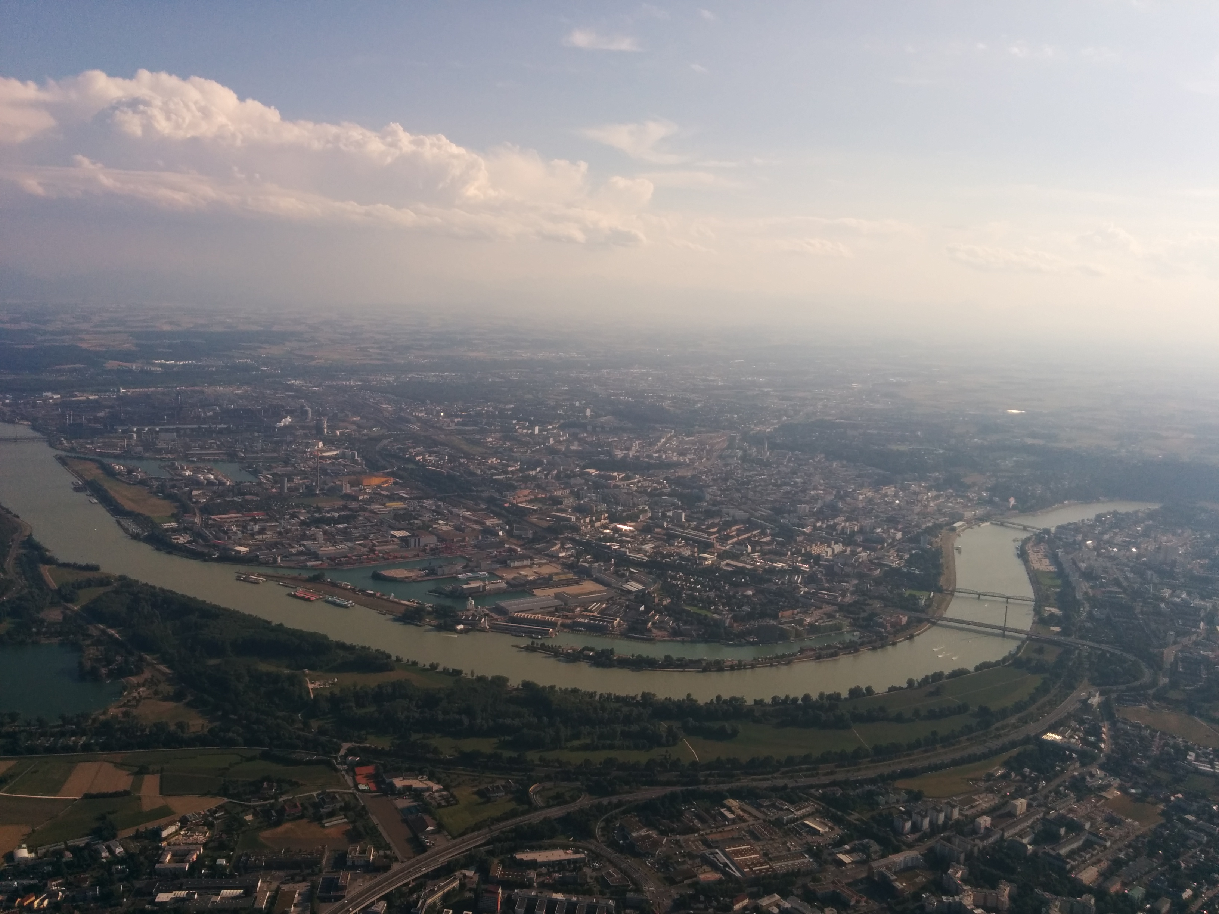

Slide 2
“Even though I am in the thralls of Perl 6, I still do all my web development in Perl 5 because the ecology of modules is so mature.”
http://blogs.perl.org/users/ken_youens-clark/2016/10/web-development-with-perl-5.html
Notes:
When I read this sentence, it kind of rubbed me the wrong way. Here’s someone who likes Perl 6, yet cannot use it for what he needs to be doing.
This is unacceptable.
I cannot believe that after so many people poured so much time into Perl 6, it should not be ready for something as mundane as web development.
So I set out on my quest to show that this sentence is misguided or just obsolete.

Slide 3
Web development and Perl 6
Notes:
So, where do we begin?
How do we show that everything is not as bad as this blogger believes?
Well I did a little survey of modules.perl6.org and had a look at everything that sounded like a web framework to me.
These are the results:

Slide 4
Bailador
BreakDancer
Crust
Web
Web::App::Ballet
Web::App::MVC
Web::RF
Notes:
As you can see, it's a reasonably short list. In itself that's not a bad thing as the list of actively developed web frameworks for Perl 5 probably is not much longer.
Of course, there are lots and lots and lots of failed attempts or abandoned frameworks on CPAN.
This raises the second question: to which category do these belong?

Slide 5
Bailador | Nov 2016
BreakDancer | Mar 2014
Crust | Jan 2016
Web | May 2016
Web::App::Ballet | Jun 2015
Web::App::MVC | Mar 2013
Web::RF | Nov 2015
Notes:
To answer this question, I had a look at the date of the last commit.
Keep in mind that the first stable release of Perl 6 as a languages was cut on December 25th 2015 and in the months immediately before this release, we did a whole lot of semantic changes that we knew we had to do before we want to commit to stability in the language.
So everything that has not been changed in or after those months can be considered either very lucky or probably bitrotted and unmaintained.
This leaves just 3 contenders.

Slide 6
“Even though I am in the thralls of Perl 6, I still do all my web development in Perl 5 because the ecology of modules is so mature.”
http://blogs.perl.org/users/ken_youens-clark/2016/10/web-development-with-perl-5.html
Notes:
No, no, no. Let's not jump to conclusions.
3 can still be a very decent pool to chose from.
Just have a look.

Slide 7
Crust
Notes:
Crust is in short a PSGI implementation in Perl 6.
It is a glue between the web framework and the web server.
Though certainly very useful, this is probably not the first thing, you'll be looking for. But let's keep it in mind for now.

Slide 8
Web
Notes:
Web can be considered one level above Crust in the stack. It gives you request and response objects and a dispatcher.
Not luxurious, but sounds like a start. Except for that it apparently does not even support fancy features like file uploads yet.
There's another thing missing that I'd consider a somewhat essential part. I will come back to this later.
For now, let's move on to the first thing we should have considered.

Slide 9
Bailador
to the rescue
Notes:
Bailador is pretty much a straight forward port of the popular Dancer framework to Perl 6. It's light weight, is being actively developed (though slowly) and brings much of what you'd expect from a web framework.
It is a little thin on the documentation and examples. But since it's a Dancer port, I resolved to just porting a canonical Dancer example to Bailador to see how well it does.

Slide 10
Thank You!
http://niner.name/talks/
http://github.com/niner/

